Slide 1
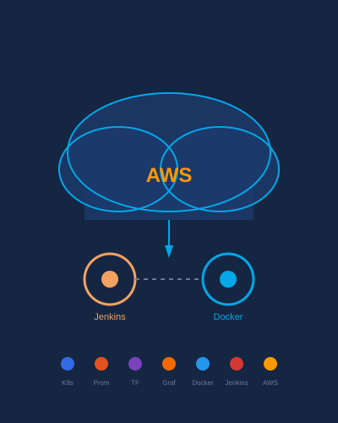

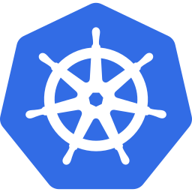


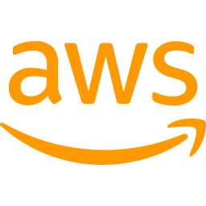


Virtual Stylist Application Deployment
using DevOps and Cloud Technologies
Your Name:
Vikhyat Saini
Reg No.:
12322613
Course:
INT377
Guide:
Ms. Arshiya
College:
Lovely Professional University

Slide 2
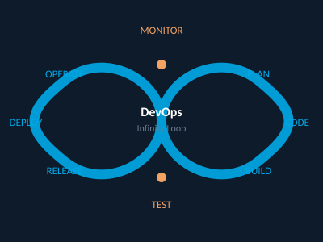

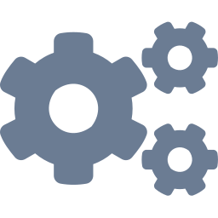


Introduction
Modern applications require automation and scalability
DevOps improves software delivery lifecycle
Cloud computing enables flexible deployment
This project deploys a Virtual Stylist application using DevOps tools
The main objective of the project is to automate the deployment lifecycle using DevOps tools and cloud infrastructure

Slide 3


Problem Statement
Problems
Solutions
Manual deployment
Scalability issues
Slow delivery
High downtime
Lack of monitoring
Automation
Continuous deployment
Scalable infrastructure
Real-time monitoring
➜
The proposed system addresses these limitations by integrating automation, orchestration, and monitoring into a unified deployment pipeline.

Slide 4

Project Objectives
Deploy Virtual Stylist application on cloud
Implement CI/CD pipeline
Use Docker for containerization
Deploy using Kubernetes
Monitor using Prometheus & Grafana
Automate infrastructure using Terraform

Slide 5

Technologies Used
Flask
Docker
Jenkins
Kubernetes
Web Application
Containerization
CI/CD Pipeline
Orchestration
Terraform
AWS EC2
Prometheus
Grafana
Infrastructure as Code
Cloud Hosting
Monitoring
Visualization

Slide 6
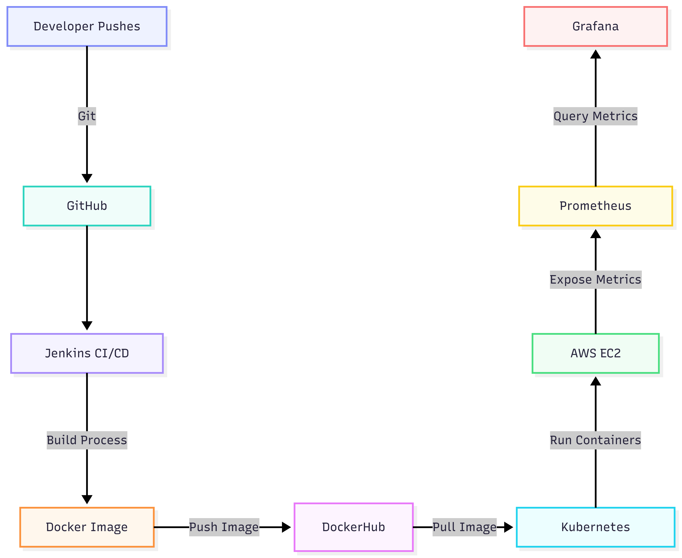
System Architecture

Slide 7
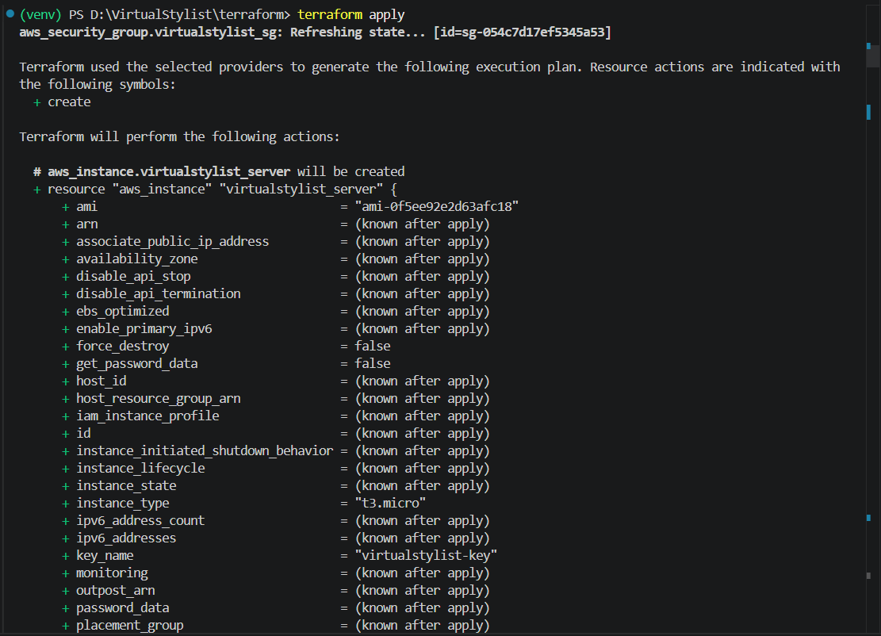
Infrastructure Provisioning using Terraform
Terraform
Infrastructure as Code approach
Automated EC2 provisioning
Security group management
Reusable cloud configuration
[ Screenshot: AWS EC2 Console ]
Terraform simplified cloud setup by allowing infrastructure provisioning through configuration files instead of manual AWS setup.

Slide 8
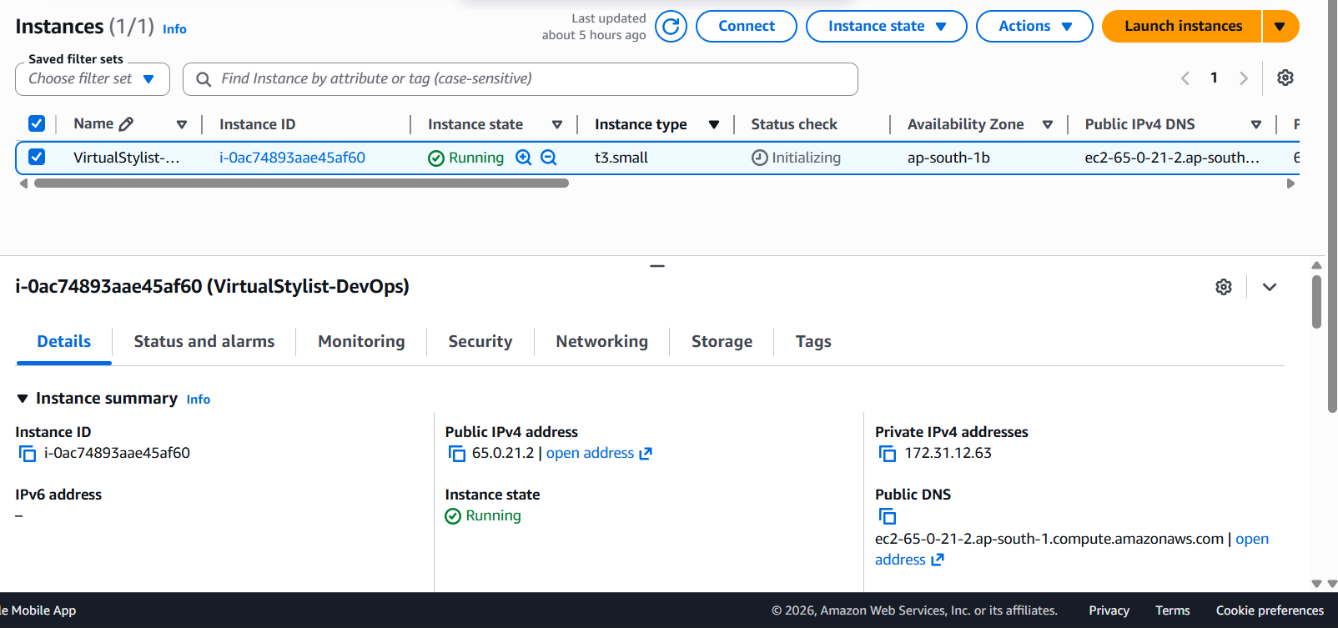
AWS EC2

Slide 9
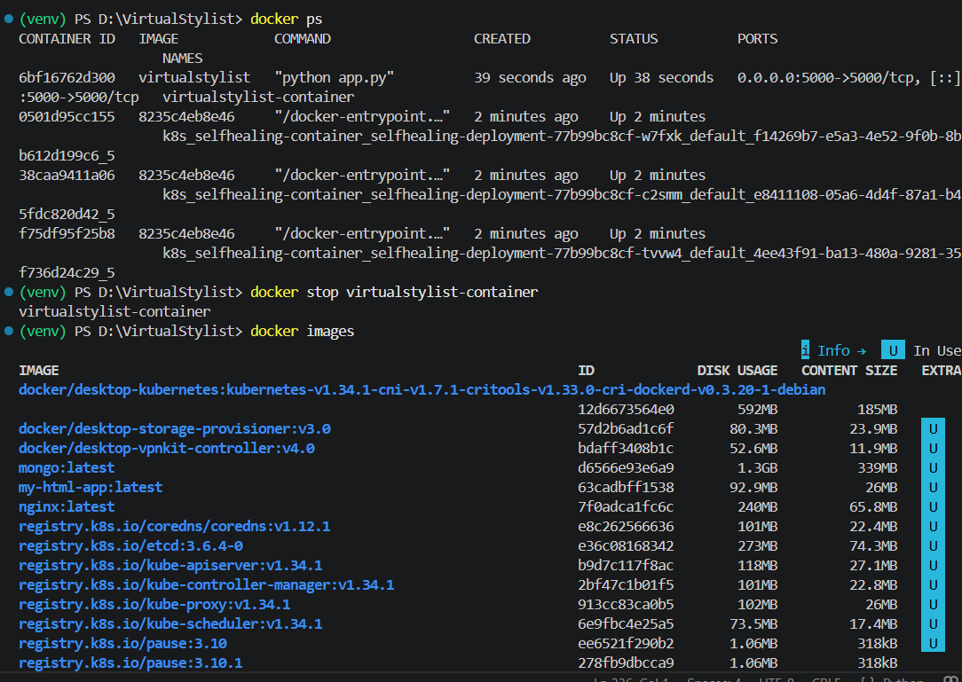
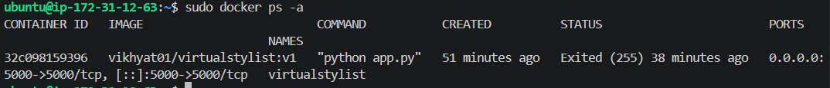
Docker Containerization
Docker
Application packaged into Docker container
Ensures portability and consistency
Simplifies deployment
[ Screenshot: docker images ]

Slide 10
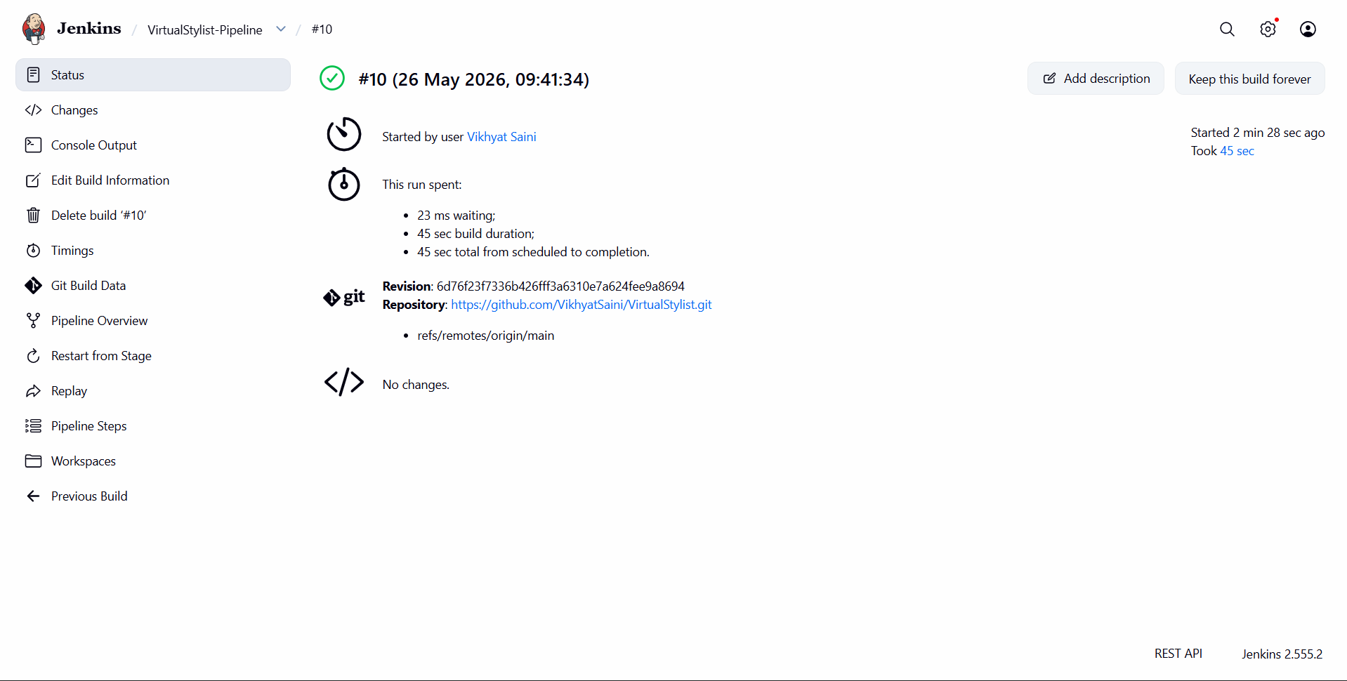

Jenkins CI/CD Pipeline
Pipeline Stages:
The CI/CD pipeline automates the software delivery process and eliminates repetitive deployment tasks
1
Pull source code
[ Screenshot: Jenkins Pipeline
(Success Build) ]
2
Build Docker image
3
Push image to DockerHub
→
→
GitHub → Jenkins → DockerHub

Slide 11
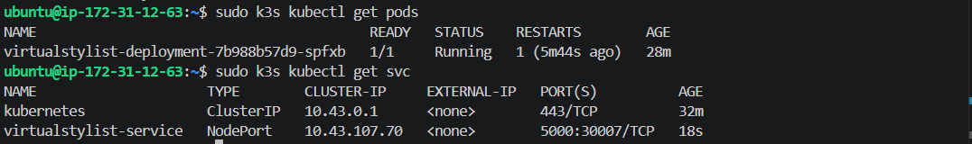
Kubernetes Deployment
K3s Cluster
Application deployed using K3s
Deployment and Service YAMLs used
NodePort service exposed application
[ Kubernetes Screenshot ]
[ Screenshot: kubectl get pods ]
[ Screenshot: kubectl get nodes ]

Slide 12
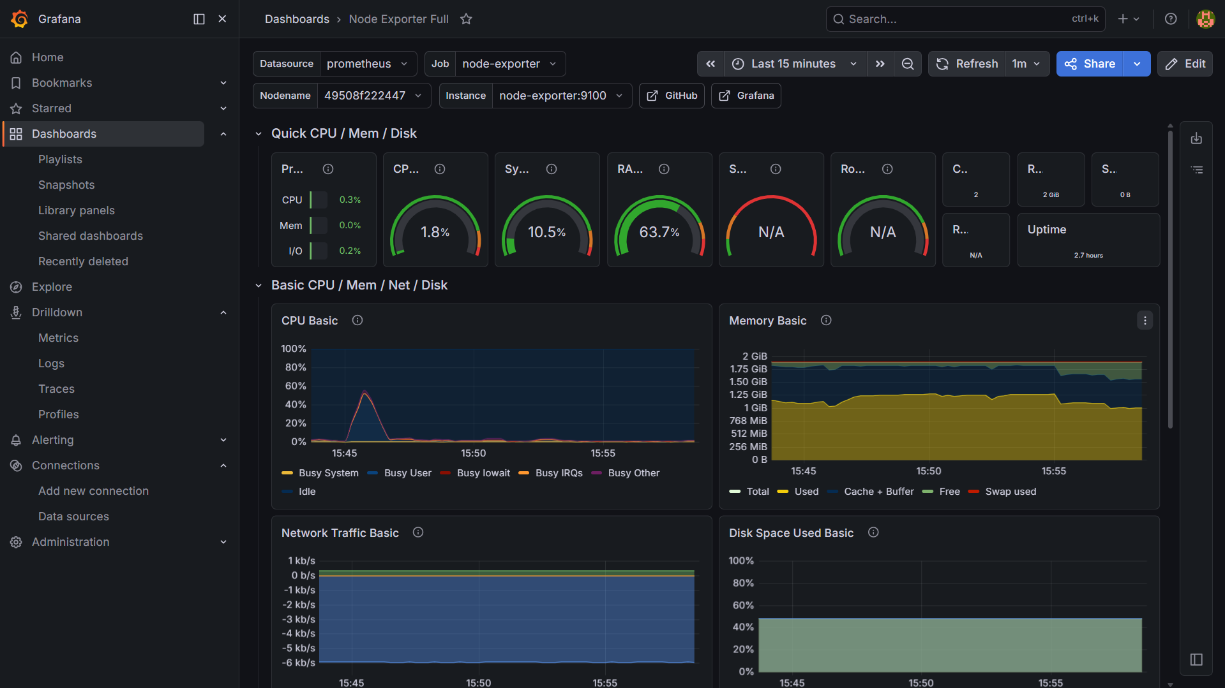

Monitoring and Visualization
Prometheus
Collects metrics
Node Exporter
Exposes system metrics
Grafana
Visualizes metrics

Slide 13
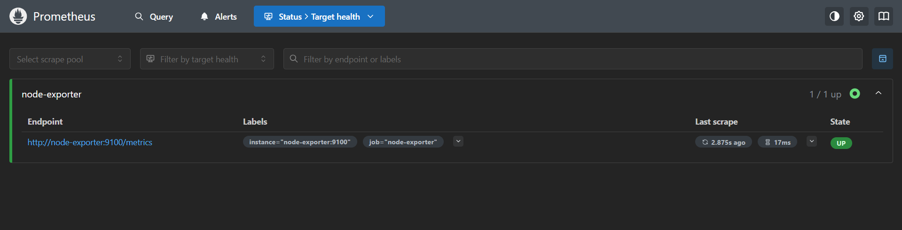
Prometheus Targets

Slide 14
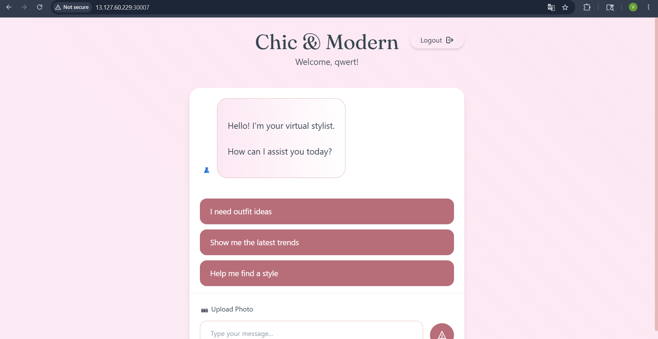
Final Application Deployment
AWS
K3s
Docker
Application successfully deployed on AWS
Publicly accessible using Kubernetes NodePort
[ Screenshot: Final Application UI ]

Slide 15


Advantages of the System
Automated deployment
Faster delivery
Scalability
Reliability
Continuous monitoring
Reduced manual effort

Slide 16
Challenges Faced
Kubernetes memory limitations
Jenkins Docker permission issues
CI/CD debugging
Monitoring configuration setup
💡 Troubleshooting these challenges greatly improved the overall learning experience.

Slide 17
Conclusion and Future Scope
Conclusion
Future Scope
Successfully implemented complete DevOps lifecycle
Automated deployment pipeline achieved
Monitoring integrated successfully
AI-based recommendations
Auto-scaling Kubernetes
HTTPS integration
Webhook automation

Slide 18
Thank You
Questions?

